Slide 1
Neural collaborative filtering

Slide 2
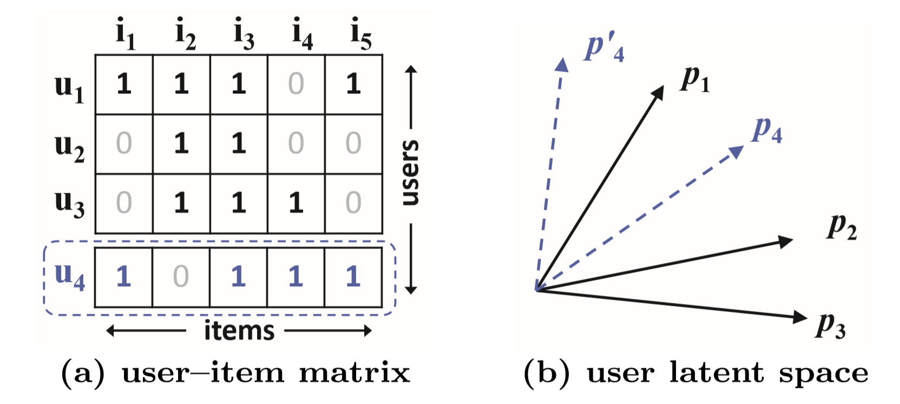
I. Introduce
Problem: learn from implicit data
Matrix factorization problem

Slide 3
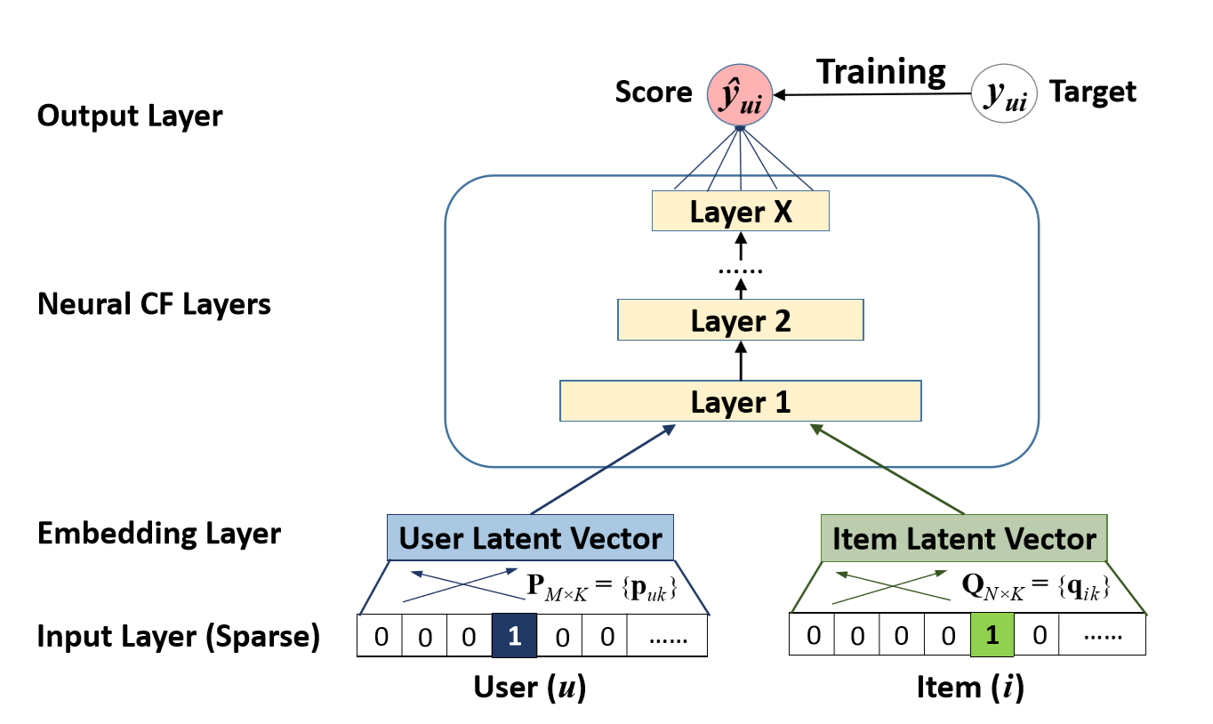
II. Neural collaborative filtering
NCF framework architecture

Slide 4
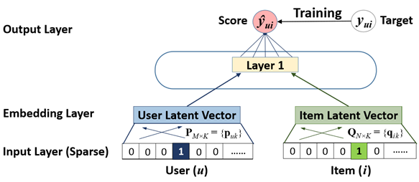

II. Neural collaborative filtering
Generalized Matrix factorization (GMF)
$p_{u}=V^{T}v_{u}^{U}$
$q_{i}=Q^{T}v_{i}^{I}$
$φ_{1}\left(p_{u},q_{i}\right)=p_{u}⊙q_{i}$
${\hat{y}}_{ui}=a_{out}(h^{T}{(p}_{u}⊙q_{i}))$

Slide 5
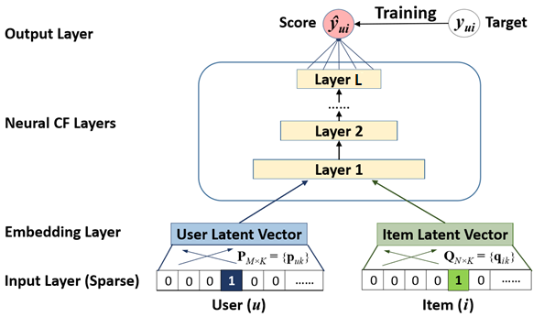

II. Neural collaborative filtering
Multi-Layer Perception (MLP)
$z_{1}=φ_{1}\left(p_{u},q_{i}\right)=\left[{p_{u} \atop q_{i}}\right]$
$φ_{1}\left(z_{1}\right)=a_{2}(W_{2}^{T}z_{1}$+$b_{2})$
…
$φ_{L}\left(z_{L−1}\right)=a_{L}(W_{L}^{T}z_{L−1}$+$b_{L})$
${\hat{y}}_{ui}=σ(h^{T}\left(φ_{L}\left(z_{L−1}\right)\right))$

Slide 6

II. Neural collaborative filtering
Fusion of GMF and MLP
$φ^{GMF}=p_{u}^{G}⊙q_{i}^{G}$
$φ^{LMP}=a_{L}\left(W_{L}^{T}\left(a_{L−1}\left(…a_{2}\left(W_{2}^{T}\left[{p_{u}^{M} \atop q_{i}^{M}}\right]\text{+}b_{2}\right)…\right)\right)+b_{L}\right)$
${\hat{y}}_{ui}=σ(h^{T}\left[{φ^{GMF} \atop φ^{LMP}}\right])$

Slide 7
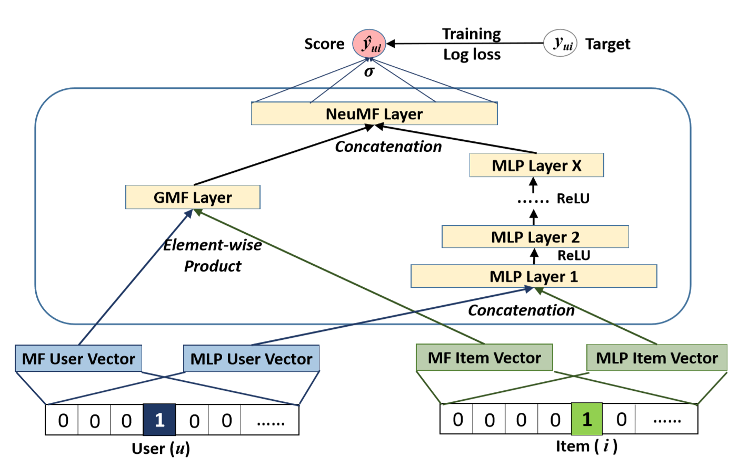
II. Neural collaborative filtering
Architecture

Slide 8
III. Experimental
Evaluation Protocols:
leave-one-out
Hit Ratio
NDCG
Baselines:
ItemPop
ItemKNN
BPR
eALS
Datasets:
MovieLens
Pinterest

Slide 9
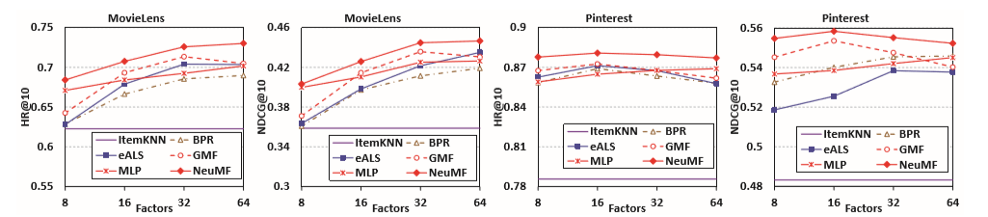
III. Experimental
HR@10 and NDCG@10 w.r.t No. of predictive factors

Slide 10
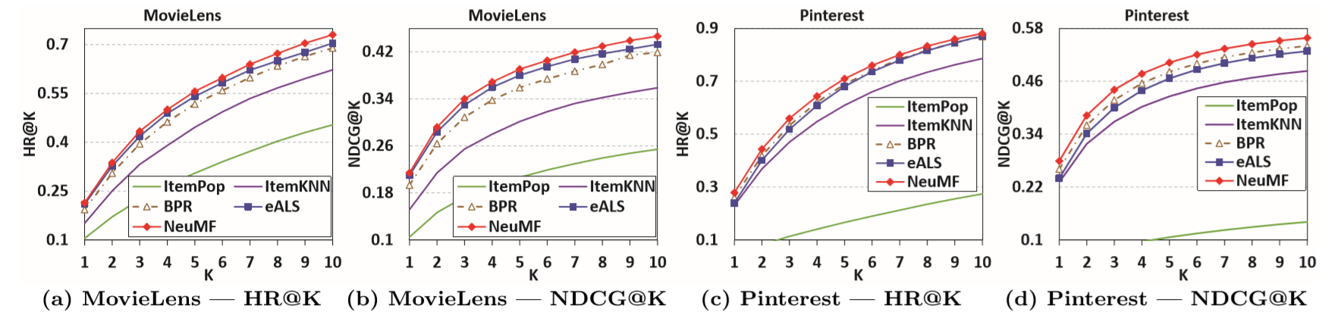
III. Experimental
Top-K items

Slide 11
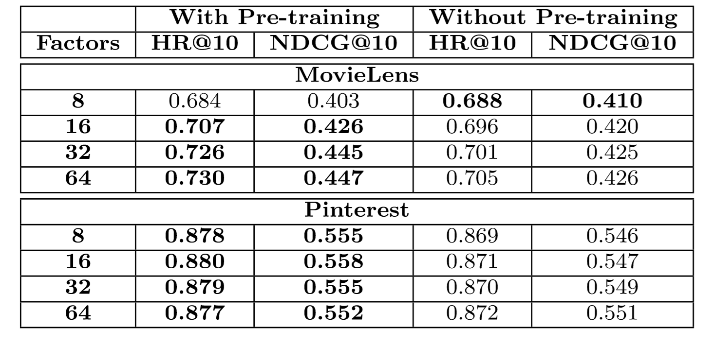
III. Experimental
Utility of Pre-training

Slide 12
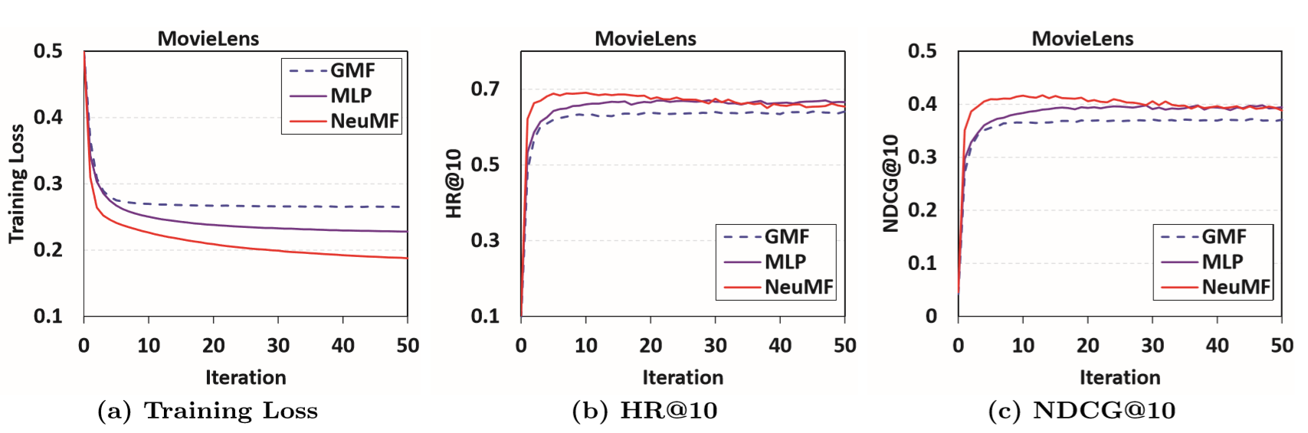
III. Experimental
Performance of NCF w.r.t No. of iterations

Slide 13
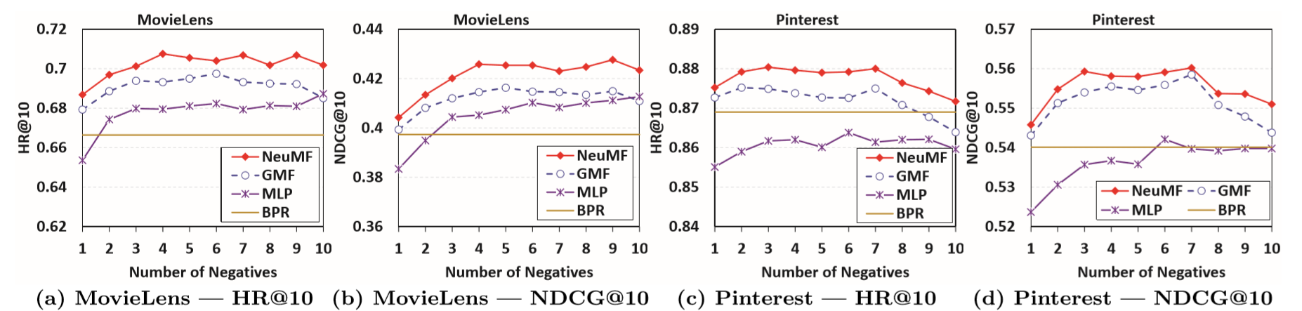
III. Experimental
Performance of NCF w.r.t No. of neg samples/ pos sample

Slide 14
IV. Modification
Previous work only use Id number of users and items as input.
Adding more features to user or item may help:
Improve accuracy of recommendation.
Cope with cold-start problem.
In this version, features are extracted from MovieLens DB

Slide 15
IV. Modification
MovieLens DB:
7000 users
27278 movies
~ 1 million positive samples
Features:
There are 19 genres of movies
Each user is represented by a vector of 19 fields corresponding to 19 genres.
User Embedded layer is replaced with Dense layer.

Slide 16
V. Modified model’s experiments

Slide 17
V. Modified model’s experiments

Slide 18
V. Modified model’s experiments

Slide 19
V. Modified model’s experiments
Other data point:
Setting | Max HR | Max NDCG | Training time (each epoch)
96 nodes, 8 factors, 4 negs | 0.803857 | 0.532013 | 1542 seconds
96 nodes, 8 factors, 8 negs | 0.810857 | 0.533491 | 2790 seconds
128 nodes, 16 factors, 4 negs | 0.802286 | 0.520887 | 2210 seconds
128 nodes, 16 factors, 8 negs | 0.808714 | 0.533082 | 4000 seconds

